Slide 1

Digital Electronic Systems
IY426
Combinational Basics-Quiz
Monday 24-Jan-2022

Slide 2
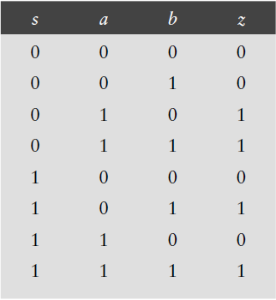
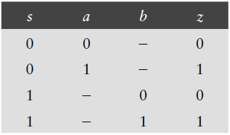
Quiz

Slide 3
Quiz
a | b | c | f
0 | 0 | 0 | 0
0 | 0 | 1 | 1
0 | 1 | 0 | 0
0 | 1 | 1 | 0
1 | 0 | 0 | 1
1 | 0 | 1 | 1
1 | 1 | 0 | 1
1 | 1 | 1 | 1
a | b | c | f
0 | 0 | 0 | 0
0 | 0 | 1 | 1
0 | 1 | - | 0
1 | - | - | 1

Slide 4


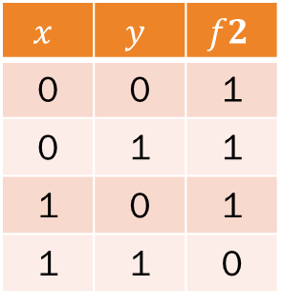


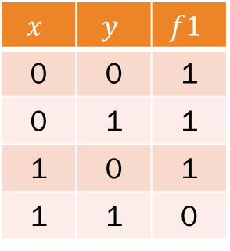
Quiz
$$f1$$
$f$2
=
$$x$$ | $$y$$ | $$f1$$
0 | 0 | 1
0 | 1 | 1
1 | 0 | 1
1 | 1 | 0
$$x$$ | $$y$$ | $$f2$$
0 | 0 | 1
0 | 1 | 1
1 | 0 | 1
1 | 1 | 0

